Slide 1
Apple Mobility Trends
The Impact of COVID-19 on Transportation
Gina Champion, Jesse Lambersky, Shyam Varanasi, Rob Volgman

Slide 2
Introduction
Situation
Problem
Objective
COVID-19 impacted the way people lived, given the switch to at-home work and school, stay-at-home-orders, and closures of businesses and leisure activities.
Currently available transportation forecasts are focused on pre-COVID habits. With the impact of COVID-19 lingering, updated models are needed in order to more accurately predict mobility trends.
Using Apple’s mobility trend data, our goal is to create a new forecasting model that accounts for the changes in transportation habits caused by the COVID-19 pandemic.

Slide 3
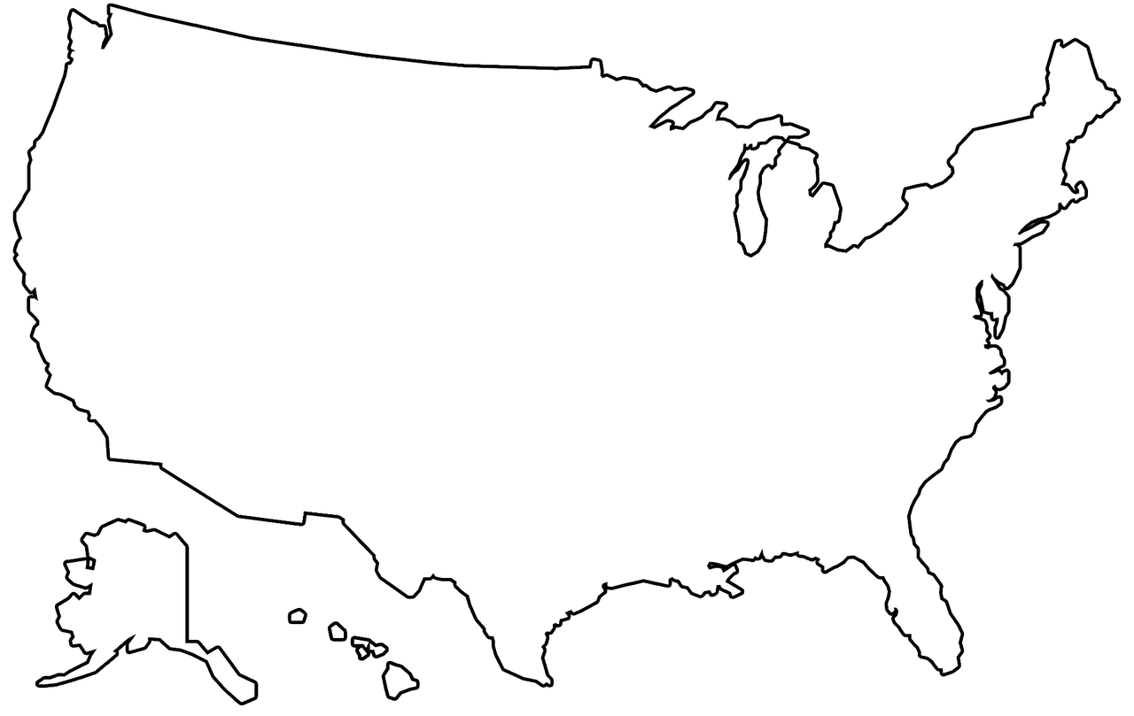


Dataset
About the Data
Data Preparation
The Apple COVID-19 Mobility Trends dataset is comprised of the relative number of requests made to Apple Maps for directions, compared to a baseline volume in January 2020.
Filter country to United States only
Filter transportation type to driving only
Values transformed to datetime format for analysis & modeling
Dropped observations where the Sub-Region was unknown
3 dates of missing data: used naive method to impute data with last observation
Attributes
Our Focus
Geography type (urban/suburban/rural)
Region (major city)
Sub-Region (state)
Country
Transportation type (driving/walking/public transit)
Relative volume of direction requests (by date)
January 13, 2020- September 5, 2021
United States
Driving

Slide 4
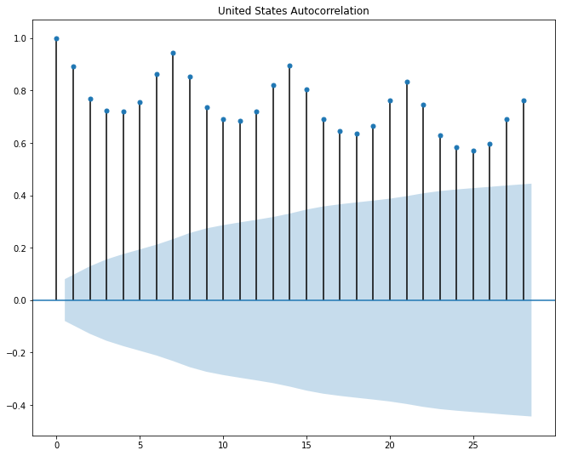
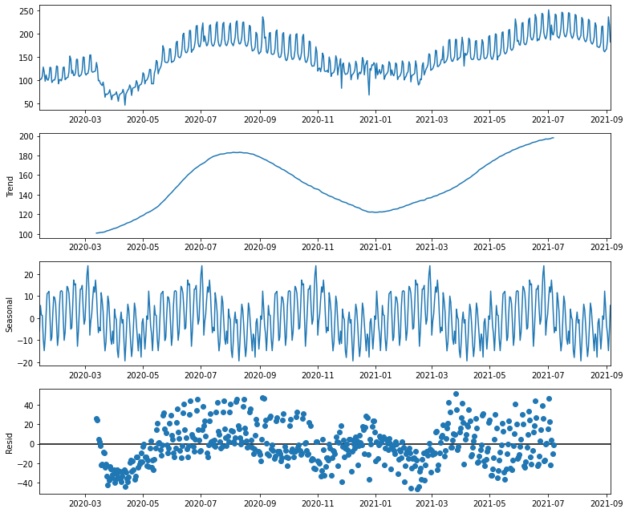
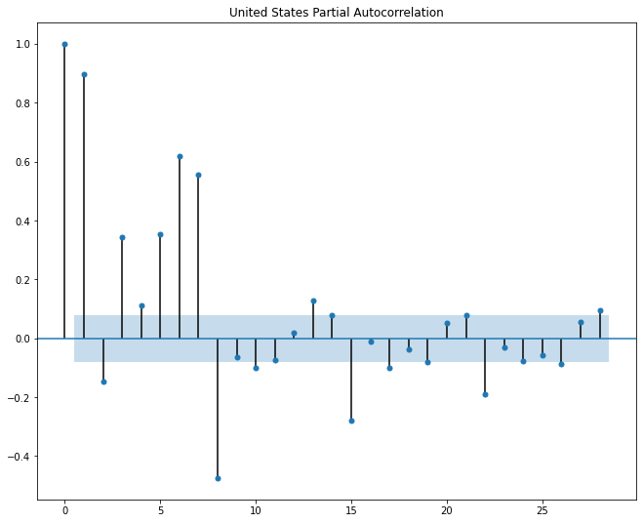
Experimental Analysis
Seasonality with some upward trend beginning in 2021
Data Exhibits Autocorrelation
Augmented Dickey-Fuller Test yielded high p-value, meaning we cannot reject the null hypothesis that the time series is non-stationary.

Slide 5
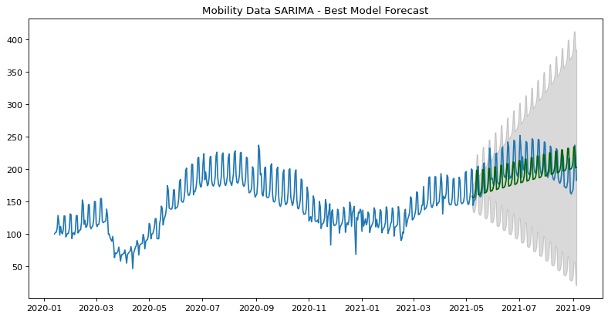
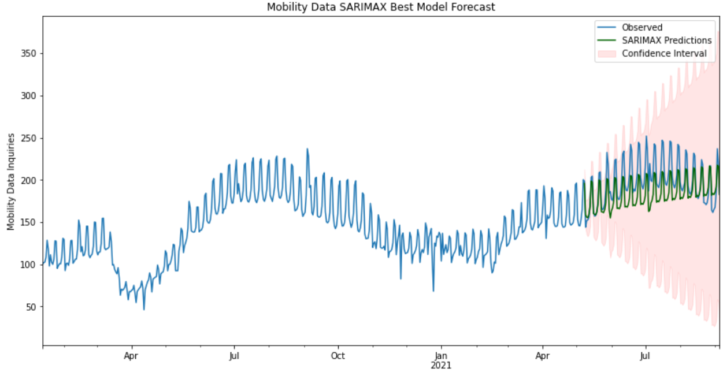
Model Selection
Model 1: Auto-ARIMA
Model 2: SARIMAX
Best model: ARIMA(2,1,1)(2,0,1)[7]
AIC: 3485.84
RMSE: 18.07
Best model: SARIMAX(2,1,1)(1,1,2)[7]
AIC: 3392.278
RMSE: 20.52

Slide 6
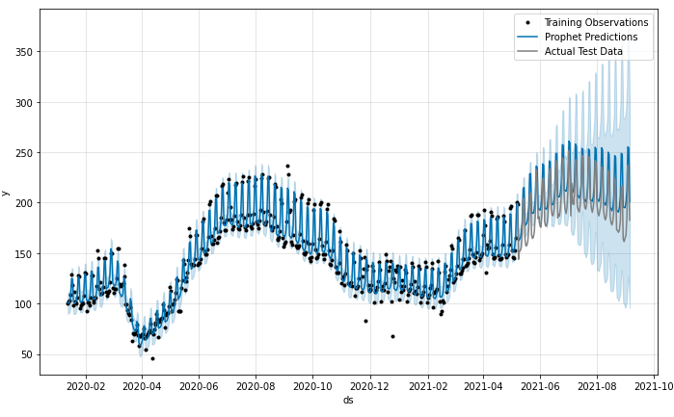
Model Selection
Model 3: Facebook Prophet
About Prophet
RMSE: 16.82
Open Source forecasting package created by Facebook based on linear and logistic regression models.
Effective on data with strong seasonal effects
Allows for multiple seasonality
Separates model “holidays” or other exceptional dates
Drawback: Fits better with more robust datasets with longer time series

Slide 7
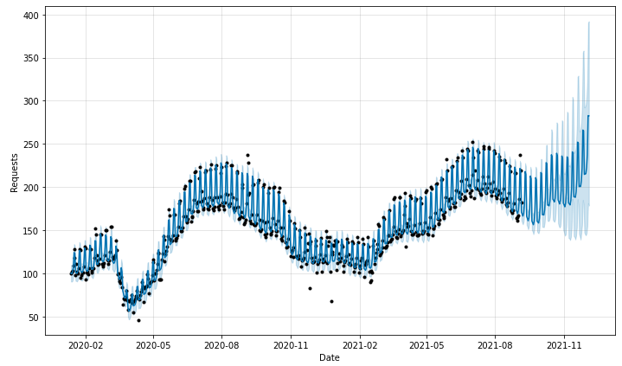
Forecast for Rest of 2021
Best Facebook Prophet Model retrained on full dataset

Slide 8
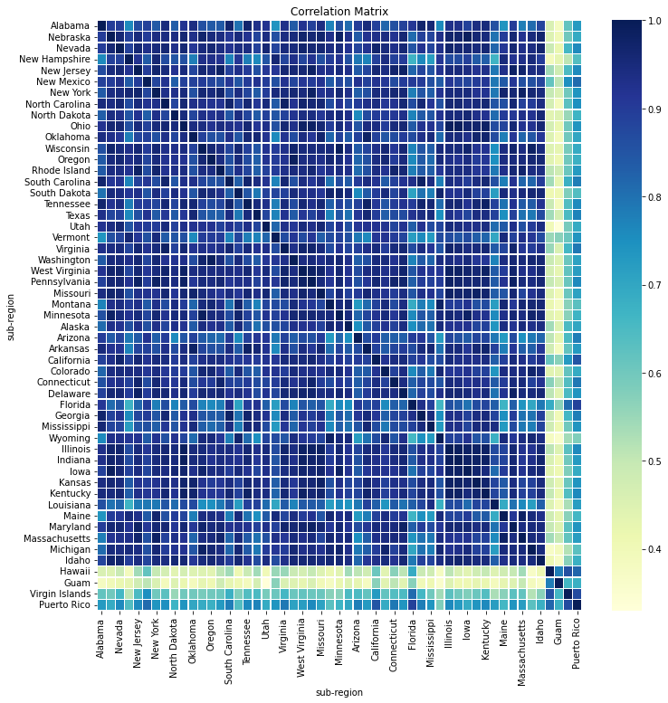
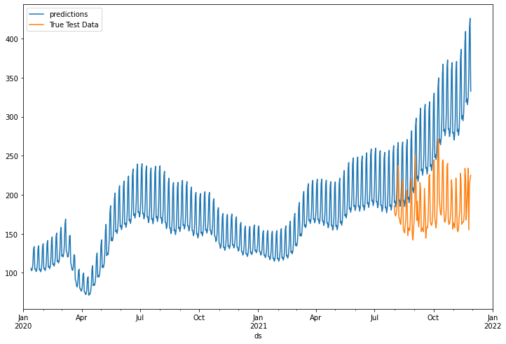
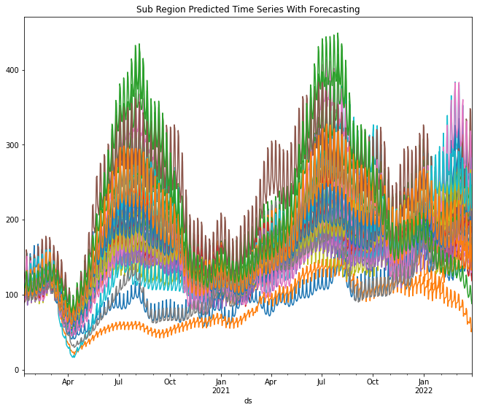
State-Level Forecasts
Some states forecasted better than others using Prophet. For example, Alabama’s predicted data had a much stronger upward trend than what was actually observed.

Slide 9


Conclusion
Best
Model
Lessons
Learned
State-Specific
Findings
Facebook Prophet performed better than ARIMA and SARIMAX due to capturing multiple seasonality
Prophet was more accurate for late Spring/early Summer predictions vs. more recent time period. More training data could help increase accuracy, and we question if Delta Variant impacted this.
Only ran Prophet for state-level forecasts; however, other models may have been better for certain states, particularly those that appear to behave differently according to the correlation matrix.

Slide 10



Future Work
Other Transportation Modes
Regressions against COVID-19 Statistics
Urban vs. Suburban vs. Rural
How were other forms of transportation impacted during COVID-19?
How were mobility trends directly impacted by the geo-specific COVID-19 outbreak severity?
How does the mobility data behave when split out by geography?
Notes:
Do for other types of transportation (walking, public transportation) as we would expect these would be impacted as well by COVID (more walking, less trains?)
Pull in data related to like # of deaths/ covid cases, etc for supplemental info/other variables?
Urban vs suburban vs rural?--how were different forms of transportation impacted based off geography?

